Slide 1
EudraCT Project
Simon Bond 30th April 2019

Slide 2
Overview
Update on Safety data project
Worked Example
Where to find resources
Opportunities to contribute
Discussion on Future extensions

Slide 3
Project Timelines: End date is October 19
Survey
Specification Document
Website
Github code sharing and collaboration
Draft versions of code
Testing
Documentation

Slide 4
Doing one thing well (to start with)
Produce summary safety stats
Advisory code not tested, or use your own
Versions for R, Stata, SAS
Data provided to link to EudraCT codes for SOCs
Standardise column names and save in “simple” XML
R package function - tested
SAS Proc Datasets (but limited by variable name length)
Stata code
XSLT script to convert from “Simple” to EudraCT xml.

Slide 5
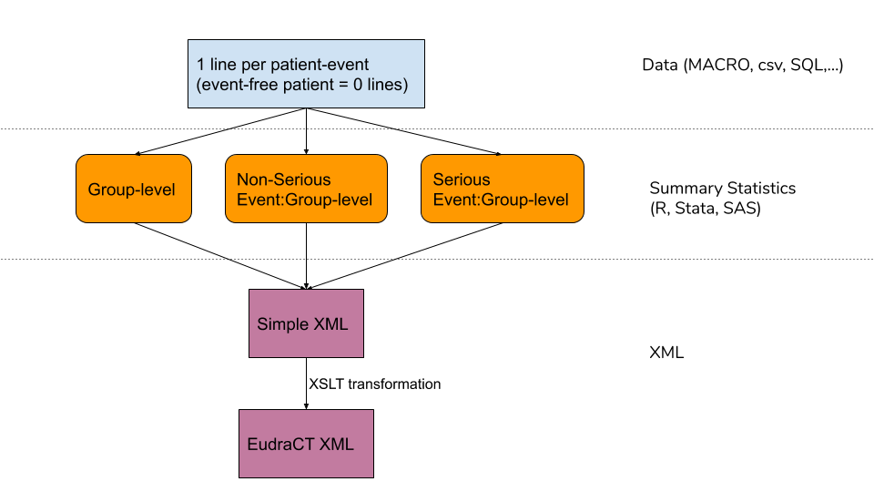
Flow Chart of process

Slide 6
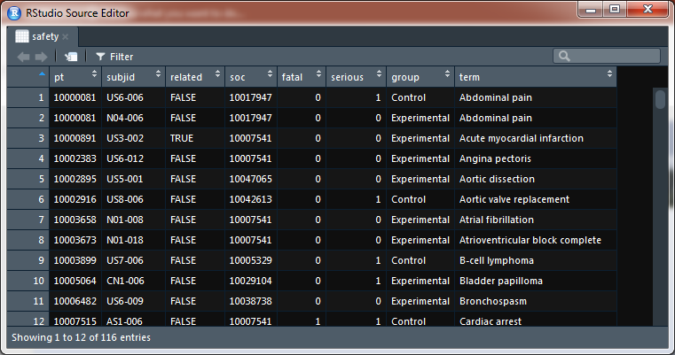
Input Data

Slide 7
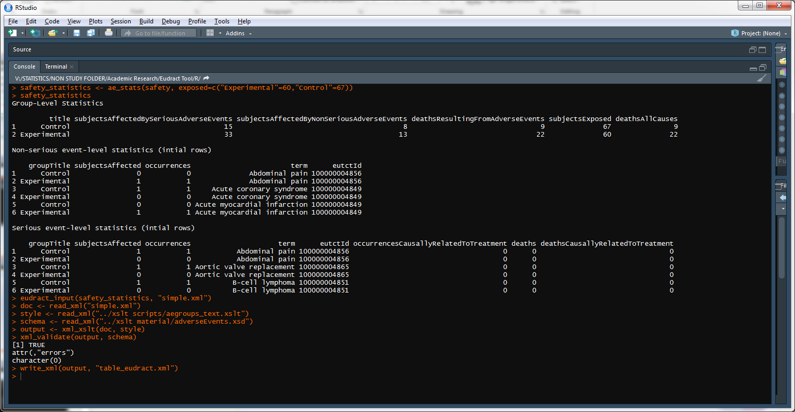
R Code

Slide 8
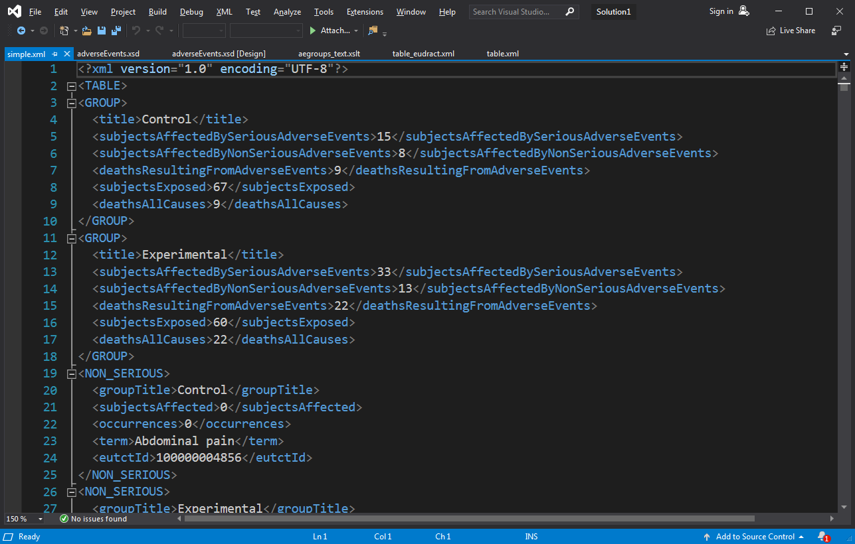
Save in Simple xml with standard names

Slide 9
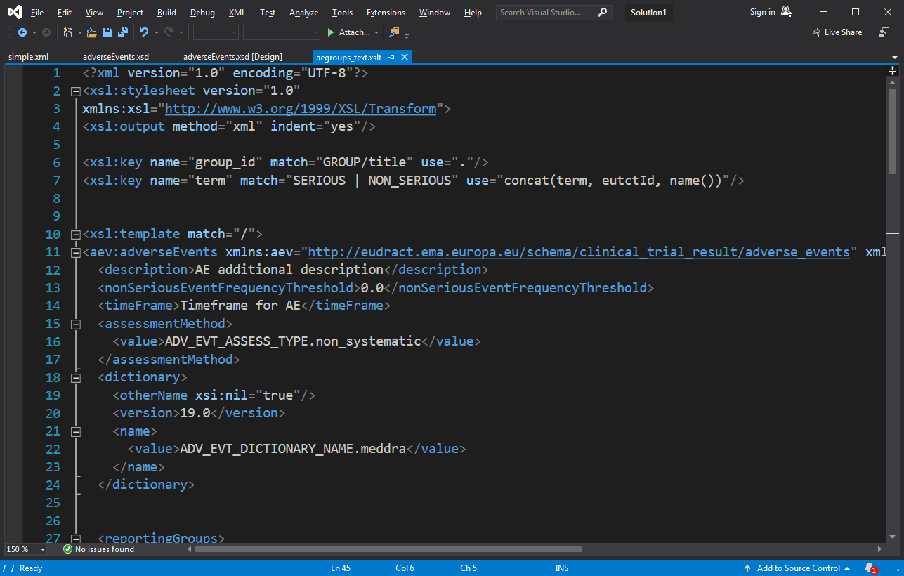
Transformation code: 108 lines

Slide 10
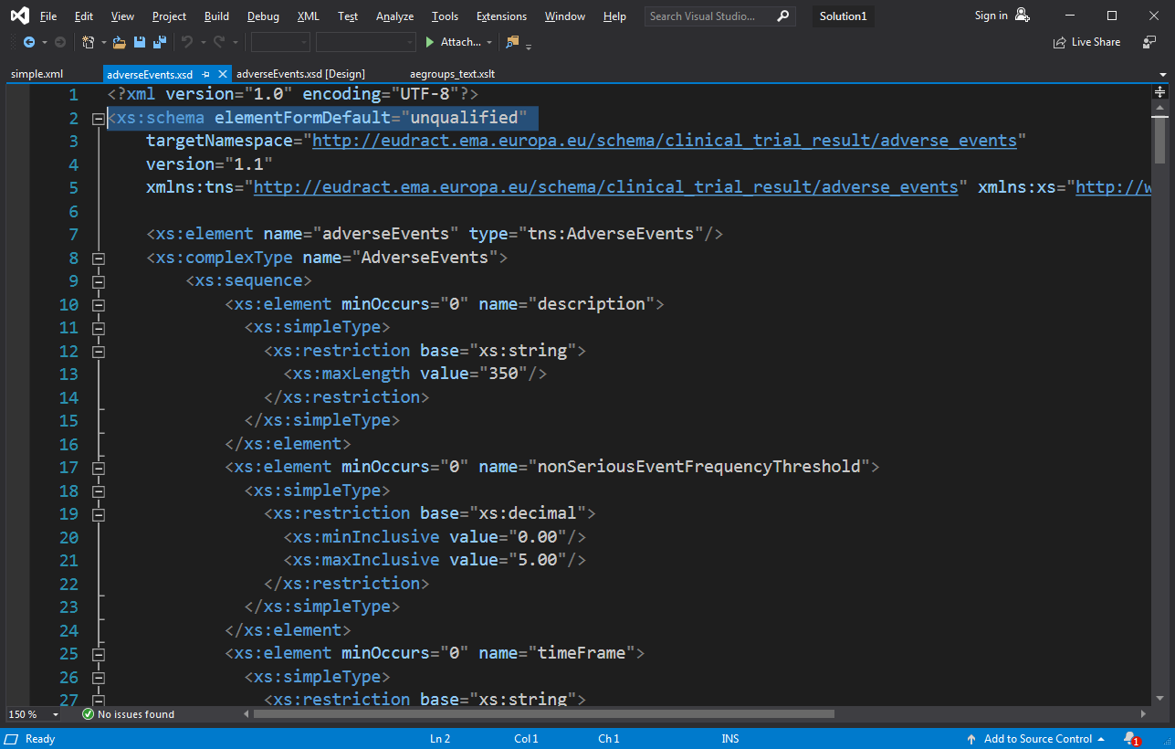
Schema downloaded from EudraCT

Slide 11
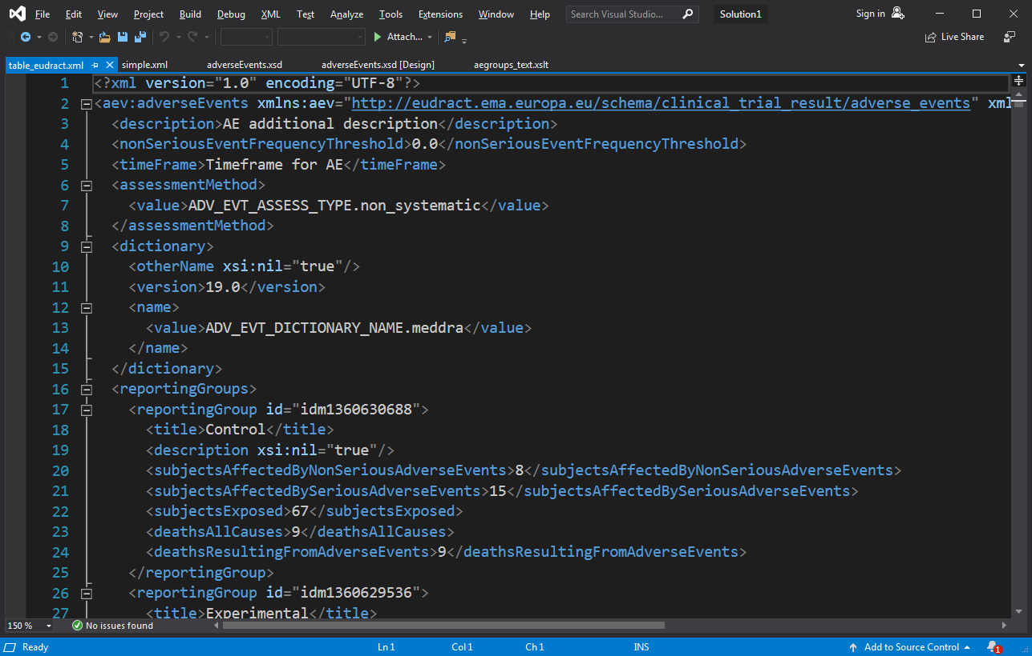
Final Output

Slide 12
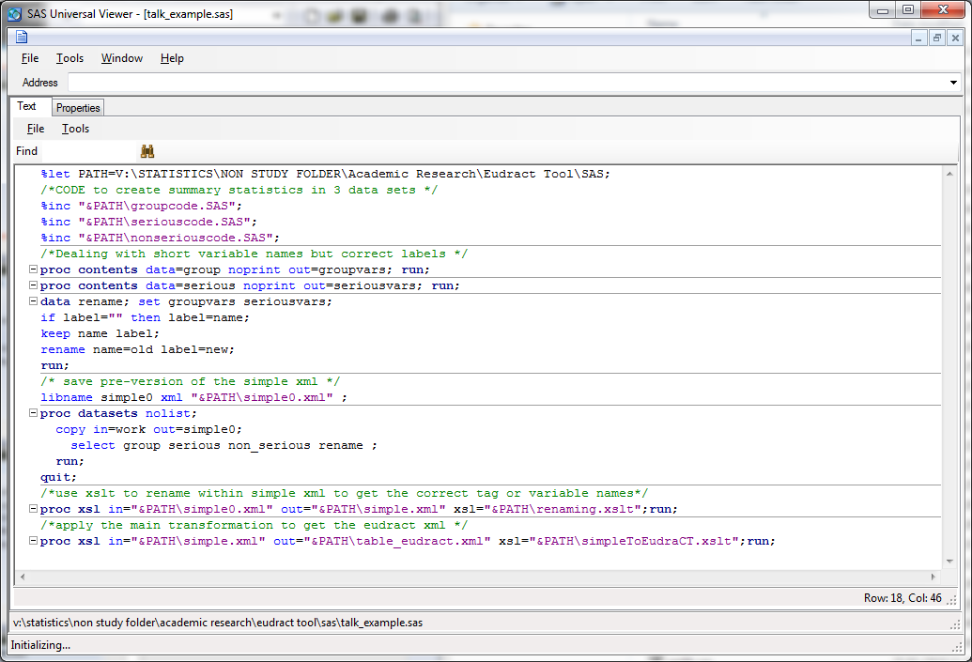
SAS Equivalent

Slide 13
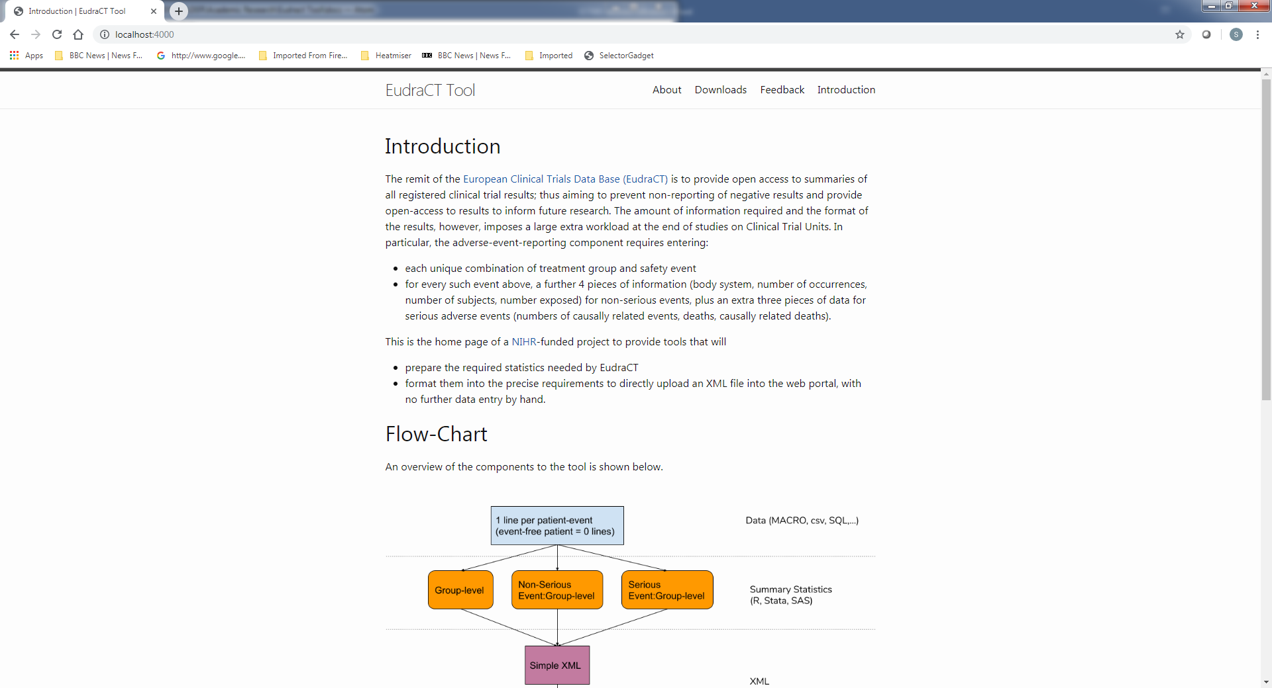
https://eudract-tool.medschl.cam.ac.uk

Slide 14
Where can you get this
R code in a zip file with worked example
SAS code equivalent..
Stata code equivalent?
R Code -> package via the github link
Documentation
Training

Slide 15
Test overview
Use the training version of EudraCT
Take a past trial already uploaded to EudraCT from another CTU, and compare output
Unit testing within R, Stata,SAS.
Feedback from other units welcome

Slide 16
Future Direction: Discussion
Extensions:
Baseline
Efficacy
Meta Data
Beyond EudraCT
ClinicalTrials.gov
CDISC

